Slide 1
VELLORE INSTITUTE OF TECHNOLOGY SOFTWARE ENGINEERING PROJECT (CSE3001)
FOOD ORDERING AND MANAGEMENT SYSTEM
TEAM MEMBERS-
1) Shaik Imran – 20BCE0009
2) Rudraksh Tandon – 20BCE0283
3) Tanmay Vyas – 20BCE0755
4) Raj Gupta – 20BCE2760
5) Jattin Jaggi - 20BCT0082

Slide 2
PROJECT ABSTRACT
Our project is a web application with the aim to provide an entire online ordering section. Customers will be allowed to select a restaurant and then go through the menu of that restaurant and choose the food items they wish to have. The user could also specify the time they want to pick up their order.
We will use HTML, CSS, and JavaScript for the front end and NodeJS and MongoDB for the backend and database, respectively. Users will have the facility to Create, Manage their accounts. Restaurants within the campus are displayed, and users can select one among them. Once the user selects the restaurant they could select items they require and the pickup time on which the user would reach out to them for their respective orders. Users can also Update and Delete their order within specific closure of time.

Slide 3
EXISTING SYSTEM
In the present scenario, The traditional food ordering procedure is not efficient enough for restaurants, as they have to deal with the crowd, in their restaurant. The Existing methods can be classified into paper-grounded and Online based.
For paper-based work, the waiter comes and pens down foods that customers order and pass the food list containing paper to the chefs or cooks in the kitchen for further process. From the owner’s point of view maintaining data records and the accounts in the physical file is cumbersome and tedious work to do. And also, it is full of risk as anyone can access it and modify the data. In this method, time and physical work is required, among which time is something that no one has in an ample amount.
For the Online based scenario, even though we can tackle the problem of data access and modification, recent Online ordering systems like Swiggy and Zomato still have the problems like food orders may not arrive by the time we were expecting, the Quality of food may differ and the person who delivers food may not be trustworthy.

Slide 4
ADVANTAGES OF THE PROPOSED SYSTEM
This system is a bunch of benefits from various points of view. This online application enables the end-users to register to the system online, select the food items of their choice from the menu list, add their possible pick-up time, and order food online. Also, the payment can be made at the time of picking up delivery depending upon the customer’s choice and convenience.
The selection made by the customers will be available to the restaurant reception or to the person handling the work assignment. Now this same person will assign the orders to the chef to be completed within the requested amount of time.
The review system in the application which describes the review of each restaurant helps in ensuring food is safe to eat and will not lead to outbreaks of foodborne illness among consumers. One of the various benefits of this system especially in the traditional system is that if there is a rush or a huge crowd present in the restaurant then in that case sometimes the unavailability of tables cuts down the restaurant’s customers. Also, there will be chances that the waiters are unavailable as they are busy handling others, so the customer can directly order the food online by using this application and pick it back up by desired time.

Slide 5
MODULE DESCRIPTION
Authentication module
Web ordering system module
Menu management system module
Order retrieval system module

Slide 6
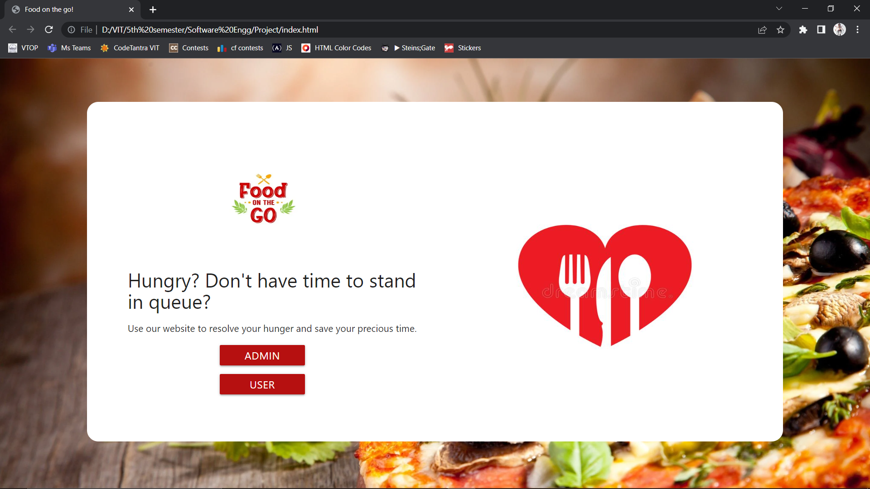
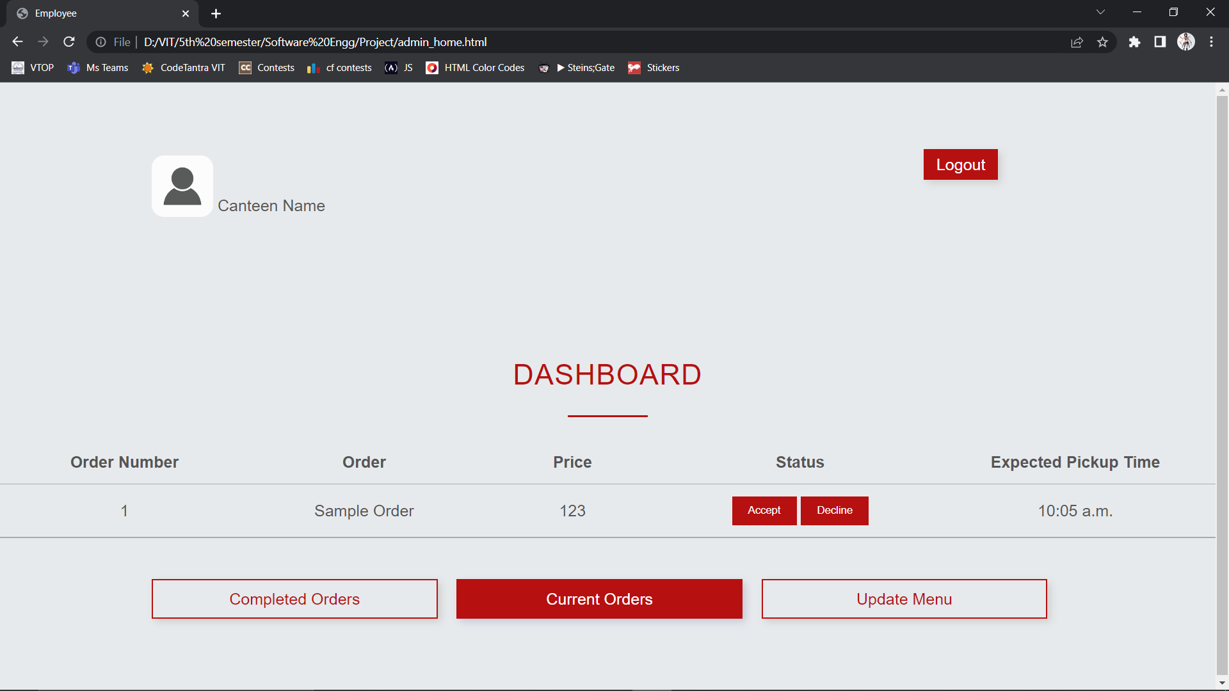
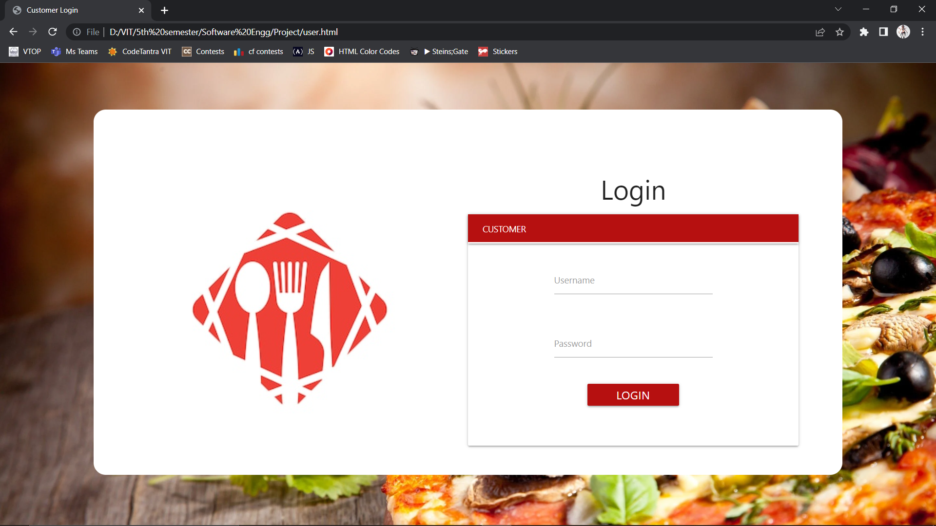

Slide 7
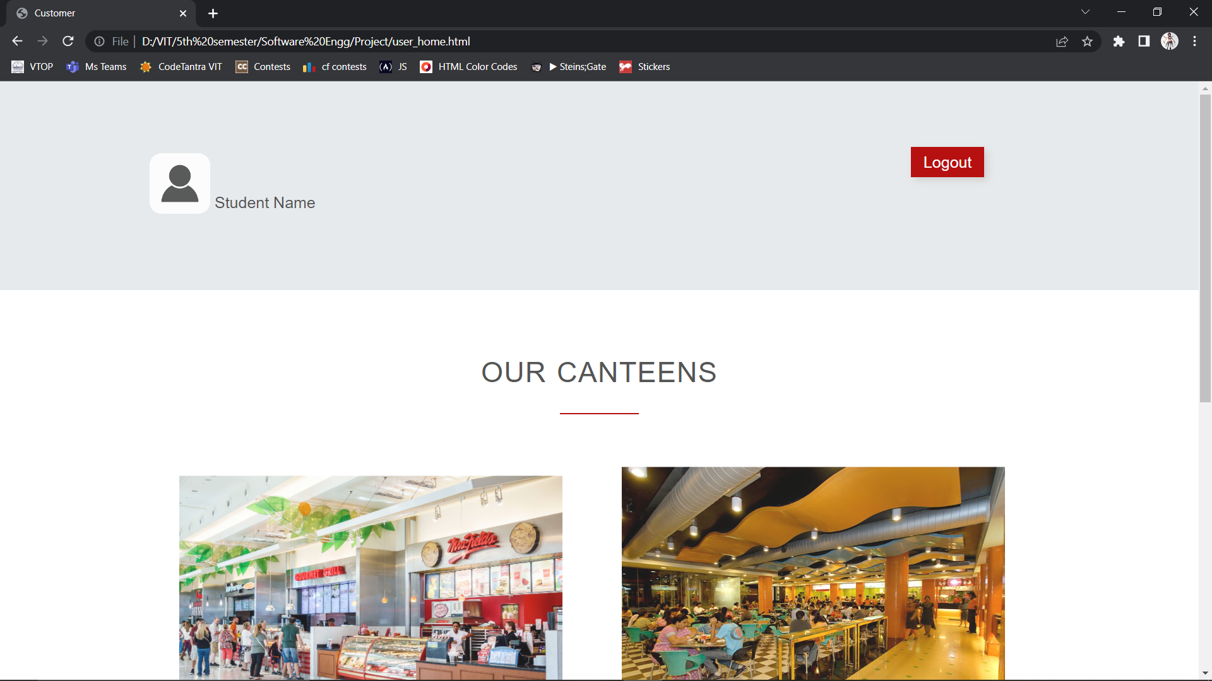
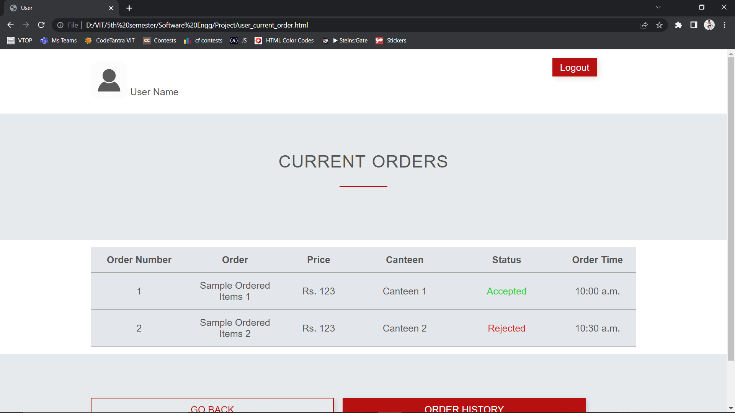

Slide 8
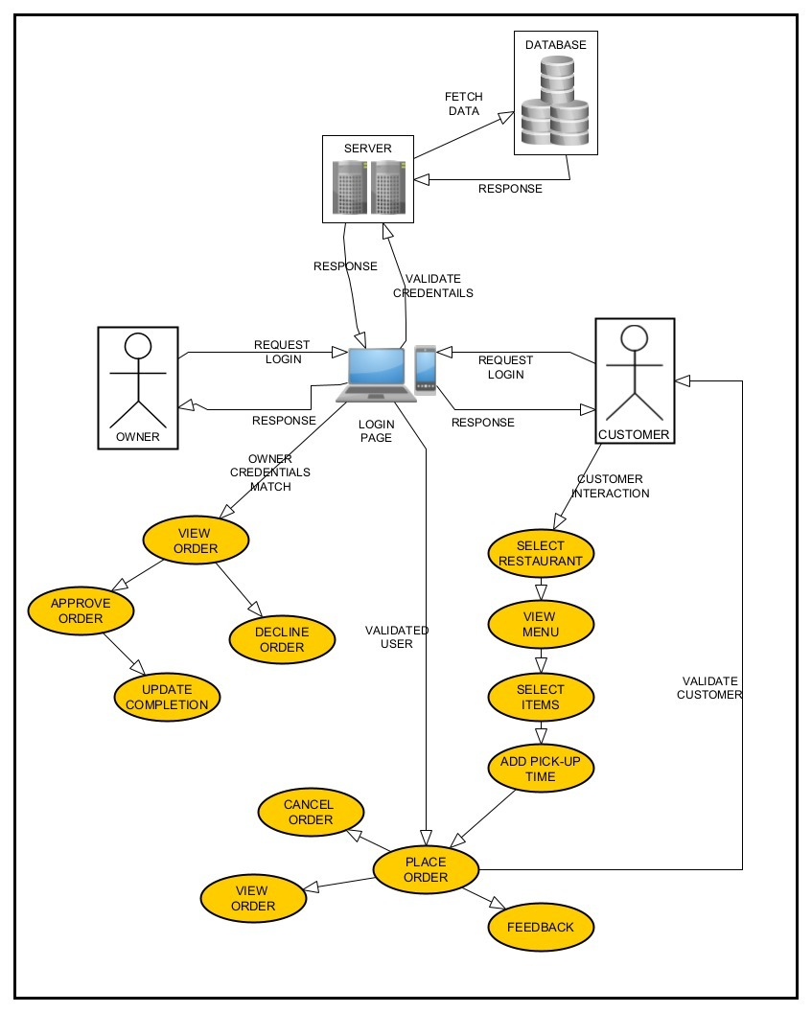
SYSTEM ARCHITECTURE

Slide 9
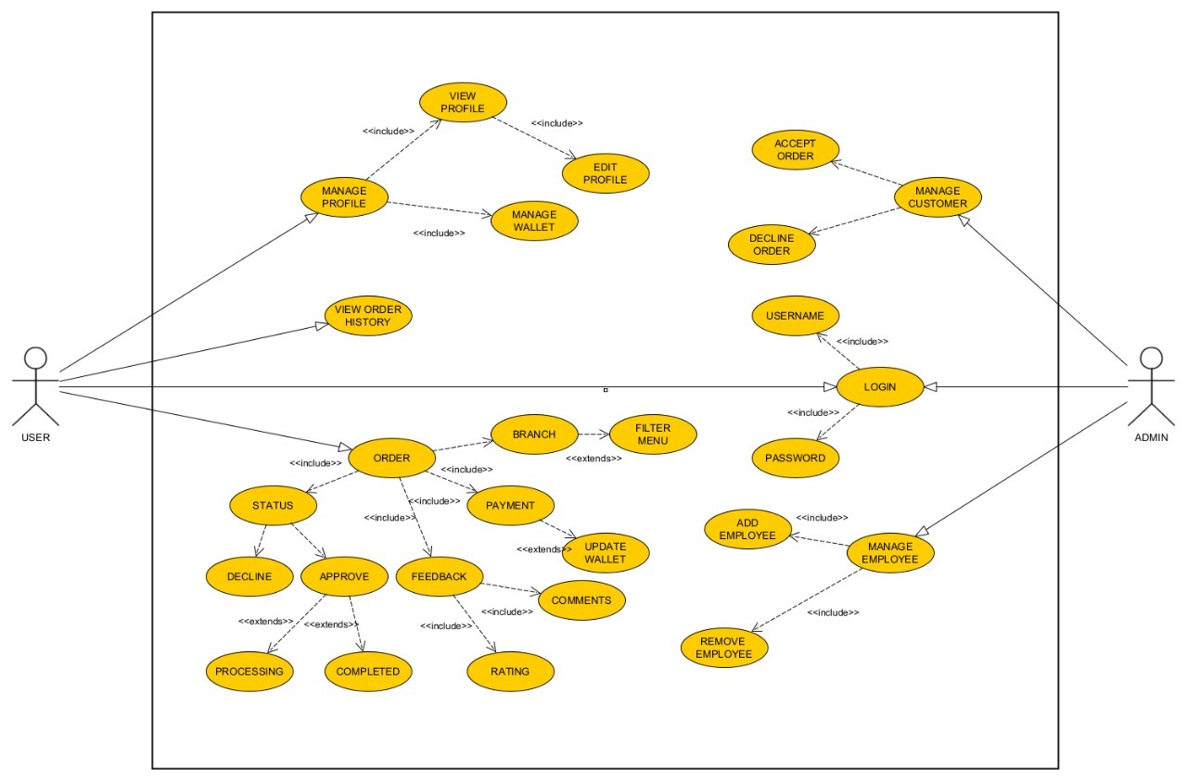
USECASE DIAGRAM

Slide 10
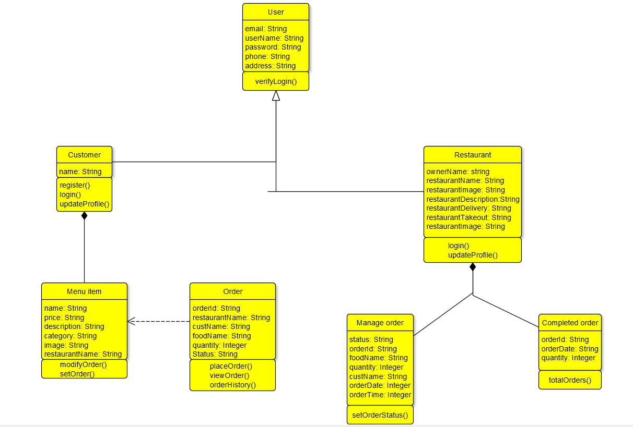
CLASS DIAGRAM

